Slide 1
Walkthroughs with a Focus on Literacy
with Syd Sexton

Slide 2
Each project is sort of like a Trojan horse. I don’t tell them, ‘You should learn kinematics or momentum,’ no. The project requires them to learn kinematics and momentum; otherwise they can’t do it.
Eric Mazur
Balkanski Professor of Physics and Applied Physics, Harvard
AP 50 Experience

Slide 3
How do you know that the author intended the double meaning of the symbol? At what point do we know the character regains hope? How do you know what that word means from the text? What words show you the melancholy tone? Which word in the declaration shows hostility? What word in the problem lets you know we subtract?
Context Clues

Slide 4
Whose content is this?
Identify the role of the U.S. free enterprise system and how it can be referred to as capitalism or the free market system.
Analyze causes and effects of events and social issues such as immigration.
Identify and sketch the general forms of linear and quadratic parent functions.
Use symbols to represent unknowns and variables.
Use patterns to generate the laws of exponents and apply them in problem-solving situation.

Slide 5
Whose content is this?
Demonstrate safe practices during laboratory and field investigations.
Compare solids, liquids, and gases in terms of compressibility, structure, shape, and volume.
Define and use the concept of a mole.
Read to infer/interpret/ draw conclusions.
Support arguments with evidence.
Resolve conflicting views encountered in source documents.

Slide 6
Four “Standards for Success” for All Disciplines “Habits of Mind”
Read to infer/interpret/ draw conclusions.
Support arguments with evidence.
Resolve conflicting views encountered in source documents.
Solve complex problems with no obvious answer.

Slide 7
Furthermore, from Mike Schmoker,
Laptops/Smartboards in every classroom
Common, content-rich curriculum
Commercial math/literacy “programs”
Basal readers
Differentiated instruction
Smaller classes
Cold calling (checks for understanding)
Various small/school-within-a-school academies
90 to 120 minutes of purposeful reading and writing per day
Cognitive/concept mapping; graphic representations
Laptops/Smartboards in every classroom
Common, content-rich curriculum
Commercial math/literacy “programs”
Basal readers
Differentiated instruction
Smaller classes
Cold calling (checks for understanding)
Various small/school-within-a-school academies
90 to 120 minutes of purposeful reading and writing per day
Cognitive/concept mapping; graphic representations

Slide 9
What needs to change?
Content
Communication
World History
Chemistry
Probability and Statistics
Water Cycle
Literature
Writing/Reading
Talking
Debate
Listening
Non-verbals
Discussion

Slide 10
What needs to be righted with writing?
Write the following sentence 100 times.
I will require therapy to ever love writing after this.
Why? Explain. Why explain?
Name: Key
Why do you keep repeating yourself? Why are you saying the same thing?
We write once in early February whether we need to or not.
Writing just for English class

Slide 12
Punishment
Capital punishment would be more effective as a preventive measure if it were administered prior to the crime.
-Woody Allen

Slide 13
Eat my shorts!
I will not sleep through my education.
I will not waste chalk.
I will not instigate a revolution.
I will not do anything bad ever again.
I will not show off.
I will not cut corners.
” ” ” ”

Slide 14
To the Blooming End
Writing questions with a clear expectation for student response

Slide 15
Straw Pan Flute Lab—Elementary Science

Slide 16
Straw Pan Flute Lab—Elementary Science
The Last Question
Most Answered
What made the difference in the notes we heard?
The Straws

Slide 17
Straw Pan Flute Lab—Elementary Science
What is your response to incorrect answers?
RtI—what do we do when kids don’t know what we thought we taught them?

Slide 18
Straw Pan Flute Lab—Elementary Science
Cloze-ish—The ______________________ changed the way _______ flowed through them. The change in flow changed the ___________________________ of the sound.
Cloze-ish—The ___________ of the straws changed the way _______ flowed through them. The change in flow changed the _____________ of the wavelength of the sound.
Don’t write “Answers will vary” on your key.

Slide 19
Straw Pan Flute Lab—Elementary Science
Discussion.

Slide 20
We have accumulated stupendous know-how. Still avoidable failures are common. The reason is the volume and complexity of what we know have exceeded our ability to deliver its benefits correctly, safely, and reliably.
The Checklist Manifesto: How to Get Things Right
by Dr. Atul Gawande

Slide 21
If I’ve said it once
Use not vain repetitions.

Slide 22
If I’ve said it once, . . .
Sharpen your malarch-ometer.
Don’t let repetition mask content that is lacking.
Don’t let a command of conventions or vocabulary do the same.
Insist on specificity of argument, explanation, or response.
At the risk of repeating myself, make your key clear.

Slide 23
Practice
Take advantage of every opportunity to practice your communication skills so that when important occasions arise, you will have the gift, the style, the sharpness, the clarity, and the emotions to affect other people.
Jim Rohn

Slide 24
What word-based practice looks like:

Slide 25
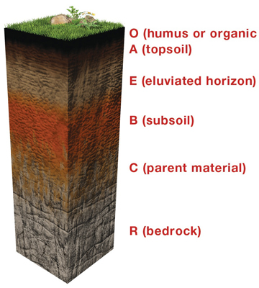
What word-based practice could look like:
Given this soil sample, what is the life story of this section? Be sure to include details about what forms each layer. Describe the processes to me as if I’m a second grader who has not yet learned about soil layers.
Alternative: Given a single type of soil, tell its life story.
Third grade soil TEKS: explore and record how soils are formed by weathering of rock and the decomposition of plant and animal remains.

Slide 26
What practice/assessment looks like:
Assignment Directions: Using the list below, shade or color the maps to indicate which European nation controlled each African or Asian territory. For cities on the Asia map, color a larger circle around the dot.
Students given a list of over fifty nations.
Africa
Belgian Congo (Belgium)
Sierra Leone (Britain)
Gold Coast (Britain)
Nigeria (Britain)
Egypt (Britain)
Uganda (Britain)
British East Africa (Britain)
Etc.
GOOGLE-ABLE

Slide 28
What practice/assessment could look like:
"For Europe to rule Asia by force for purposes of gain, and to justify that rule by the pretense that she is civilizing Asia and raising her to a higher level of spiritual life, will be adjudged by history, perhaps, to be the crowning wrong and folly of imperialism. What Asia has to give, her priceless stores of wisdom garnered from her experience of ages, we refuse to take; the much or little which we could give we spoil by the brutal manner of our giving. This is what imperialism has done, and is doing, for Asia.“ –J.A. Hobson, 1902
Does Hobson condone or condemn European imperialism in Asia?
Imagine that you are a European reading this excerpt at the turn of the last century. Would you be for or against imperialism?
NOT GOOGLE-ABLE
World History TEKS: Identify major causes and describe the major effects of the following important turning points in world history from 1750 to 1914: . . . European imperialism . . .

Slide 29
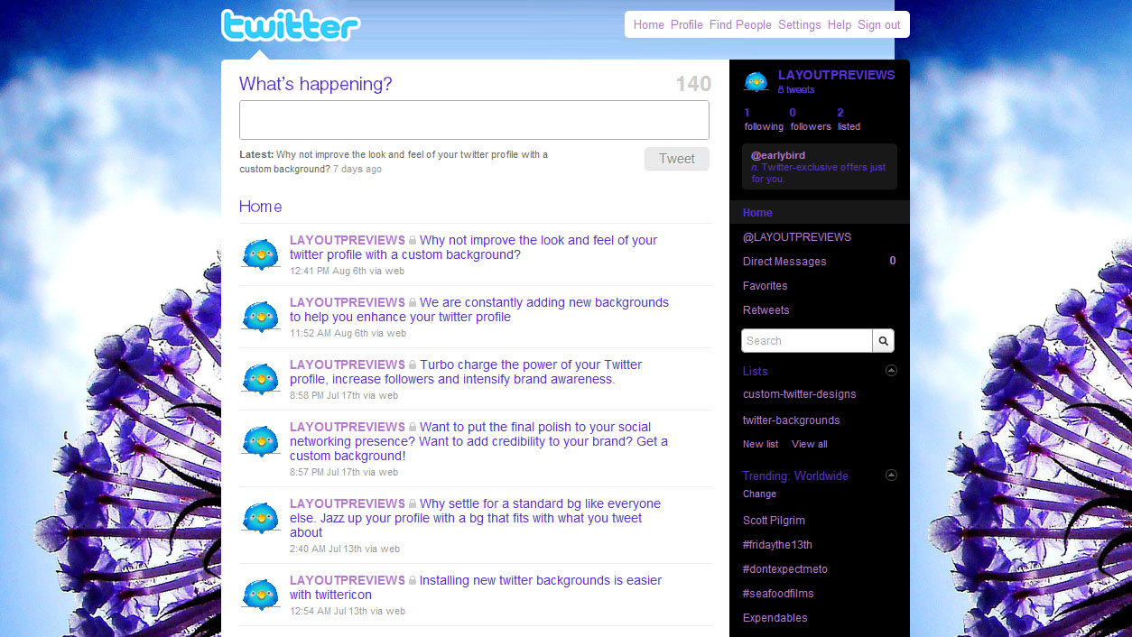
#yeahweownthat #thattoo #fishandchips

Slide 30
Writing in Math?
https://www.madewithcode.com/
http://code.org/
http://scratch.mit.edu/
http://www.alice.org/index.php

Slide 31
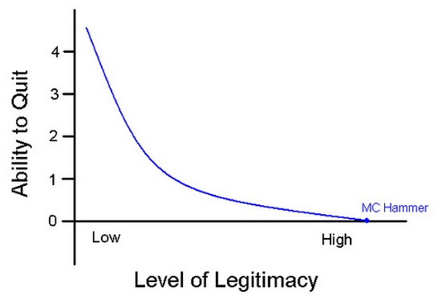

Slide 32
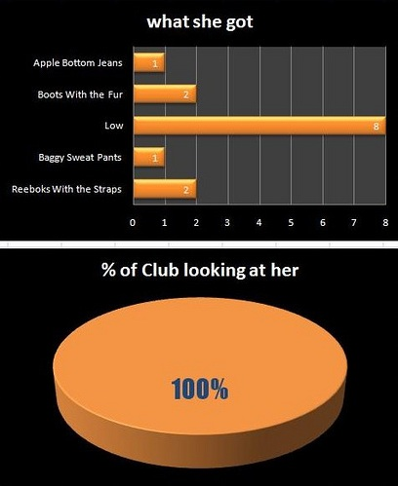

Slide 33
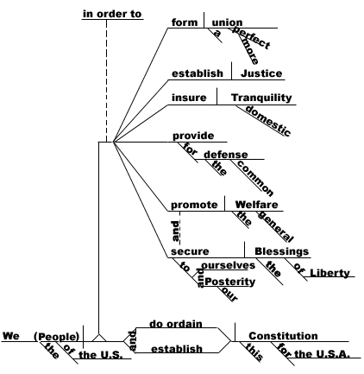
It’s a sentence, it’s an image, and it’s downright mathematical.
https://roskylegaled.com/blog/post/blawg-review-302/

Slide 34
Word Trees:
A visual search tool for unstructured text→reveals heart of data set (http://hint.fm/). Created using Many Eyes.

Slide 35
Unconventional Writing
I would rather eat cake then eat ice cream. If you’re good with grammar, you’ll get it.

Slide 36
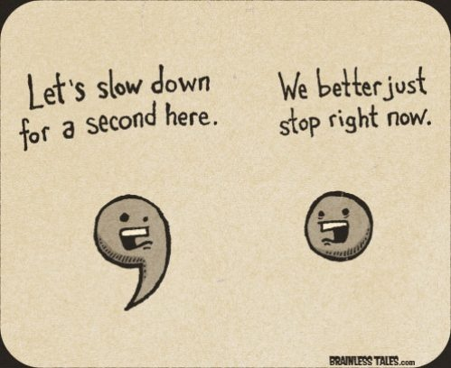
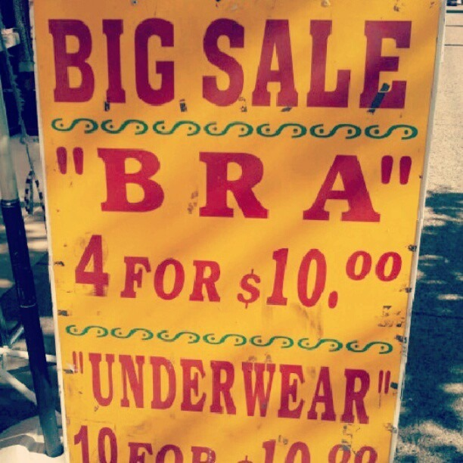
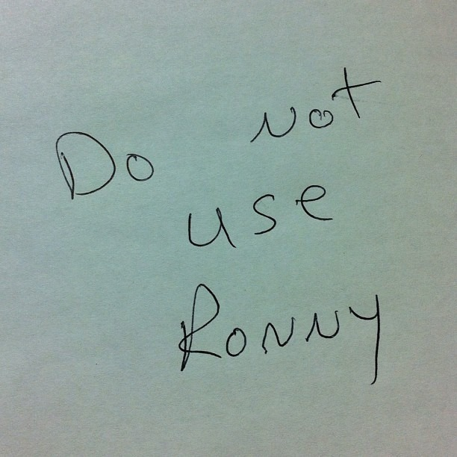
Because some of us have a “Grammar” pin board:

Slide 38
Grade What You Need
Begin
Idea generation
Logical progression of an explanation or defense
Cause and effect notation
Comparison/contrast to prove understanding
Hypothesis
Evidence of learning (just the facts)
Move Towards Grading for College Prep (11-12)
Standard expectations for individual content areas
College-level expectations for number, length of papers

Slide 39
Build a Day
90-120 Minutes

Slide 40
Every Day
What content am I teaching?
How will I teach it?
What will my kids read, discuss, or write?
How will I know my students learned?

Slide 41
Thank you!
Syd Sexton
ssexton@esc17.net

